Slide 1
Patient & Hospital Insights through SQL

Slide 2
Project Objectives
Analyze patient demographics based on age, gender, and city.
Examine hospital appointments and doctor-wise consultations.
Identify department-wise consultation activity.
Analyze consultation fees and revenue distribution.
Understand monthly appointment trends and cumulative revenue using SQL.

Slide 3
DATASET OVERVIEW
Dataset: Patient & Hospital Appointment Data
Database Tables: 2
Patients Table — 150 Records
Patient ID
First name & last name
City
Gender
Date of birth
Appointments Table — 50 Records
Appointment ID
Patient ID
Appointment date
Doctor name
Department
Consultation fee
Relationship: Both tables are connected using patient_id.
Tool Used: Mysql

Slide 4

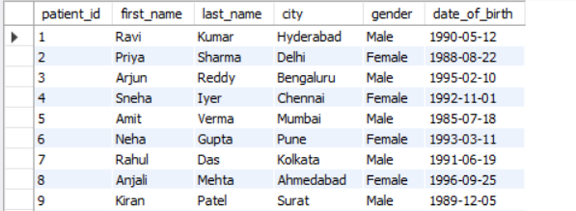

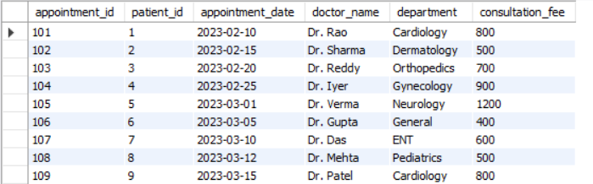
Queries

Slide 5




Total No.of Doctors
Output :
Total No.of Patients

Slide 6
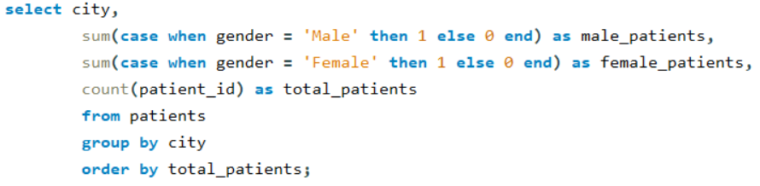
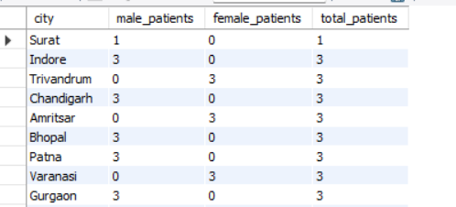
Patient Count By Gender & City
Output :

Slide 7
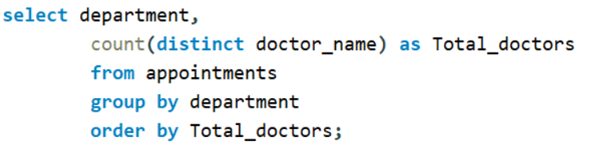
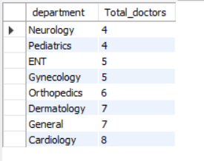
No.of Doctors Department wise
Output :

Slide 8
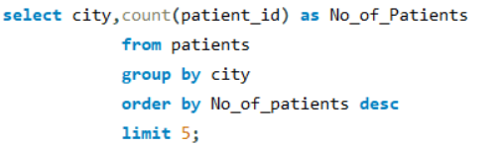
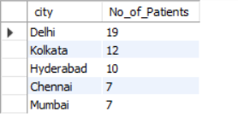
Top 5 cities having the highest number of registered patients
Output :

Slide 9
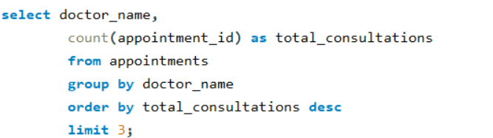
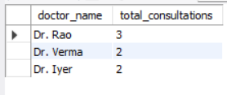
Top 3 doctors who have handled the highest number of patient consultations
Output :

Slide 10
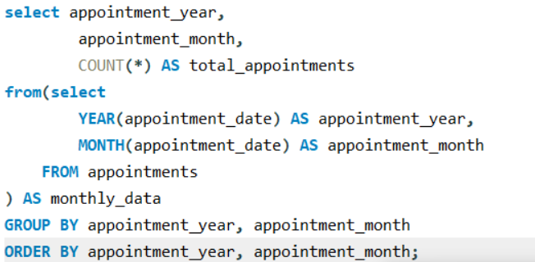
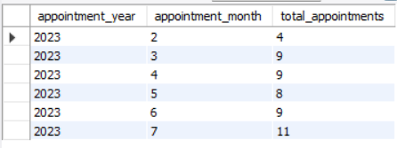
Monthly Appointment Analysis
Output :

Slide 11






Minimum Consultancy fee
Maximum Consultancy fee
Average Consultancy fee

Slide 12

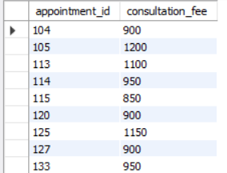
Appointments where the consultation fee was greater than ₹800
Output :

Slide 13
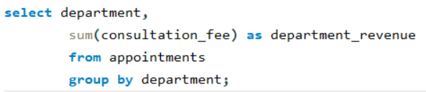
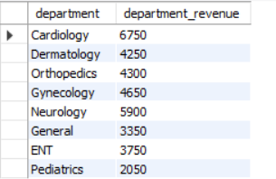
Total consultancy fee generated by each department
Output :

Slide 14
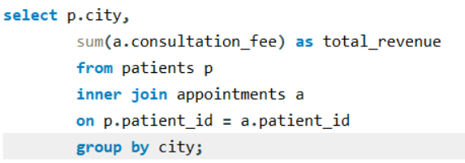
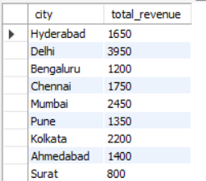
Total revenue generated from patients residing in each city
Output :

Slide 15
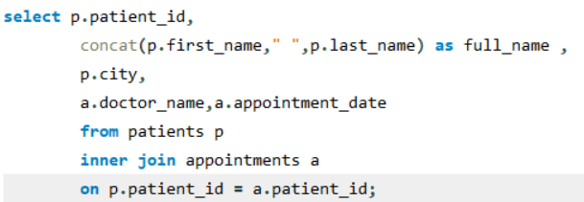
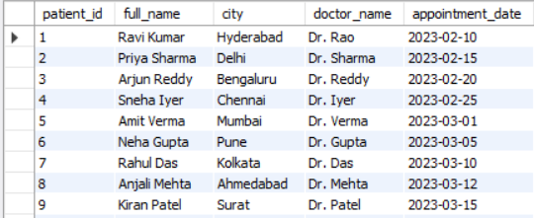
Retrieving detailed appointment records, including patient demographic info and assigned doctors
Output :

Slide 16
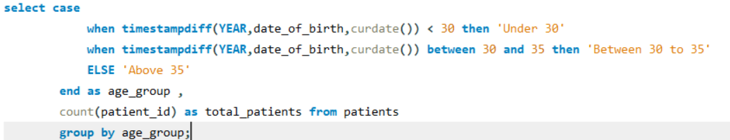
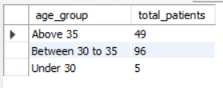
Evaluating patient population distribution by calculating current ages and grouping them into targeted age categories
Output :

Slide 17
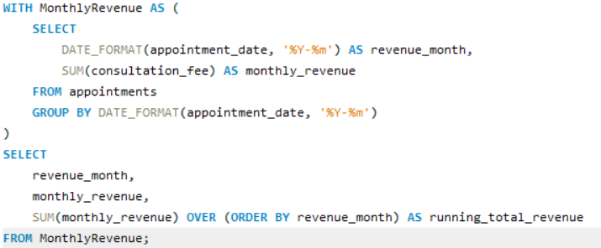
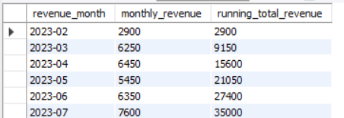
Monthly Revenue & Cumulative Revenue Analysis.
Output :

Slide 18
1. Analyzed 150 patient records and 50 hospital appointments.
2. Identified 42 unique doctors, with Cardiology having the highest count (8).
3. 64% of patients belong to the 30–35 age group.
4. July recorded the highest number of appointments (11).
5. Consultation fees ranged from ₹400 to ₹1,250, with an average of ₹700.
6. Total consultation revenue reached ₹35,000, with July generating the highest monthly revenue of ₹7,600.
KEY FINDINGS & INSIGHTS

Slide 19
Thank you…!!!

